Slide 1
Phones, Social Media, and Middle School: Literacy in the Language of the New Generation

Slide 2
Why this workshop?
How are today’s children using phones, social media, and the internet, and how is that different from how adults use these technologies?
What are potential issues that arise with children and these modern communication methods, both at school and at home?
What can we all do to help young people through the unique challenges they face as members of the Social Media Generation?

Slide 3
How and why are phones used?
Pew research: 92% of teens report going online daily – including 24% who go online “almost constantly.”
Teens use their phone for:
Social media.
Movies and TV (Netflix)
Communicating with friends and family.
Checking grades, working on school work.
Reading articles and stories.
Staying updated with current events.
Staying organized.

Slide 4
Phone use at King
Phones are to be turned off, and kept out of sight, unless specifically granted permission by a teacher.
Unpermitted phone use at school results in disciplinary consequence and phone confiscation.
The school is not responsible for lost or stolen phones.
Refusal to turn over a phone when requested by staff results in a disciplinary consequence.

Slide 5
What Apps are being used?
Instagram: social media for sharing selfies, pictures, or short videos.
Potential issues:
“Likes” and followers determine value.
Potential monitoring by strangers.
Private messaging.

Slide 6
What Apps are being used?
Snapchat: photo and video messaging system. “Snaps” can be set to disappear after a set time limit.
Potential issues:
Illusion of privacy.
Frequent digital drama.
Can be a gateway to sending inappropriate pictures.

Slide 7
What Apps are being used?
Kik: free instant text messaging service.
Potential issues:
When kids know parents check texts, they often message on Kik.
Stranger danger can be an issue.

Slide 8
Potential Issues: Distractibility
University of Michigan found that in schools that permitted students to have cell phones, 71 percent of students sent or received text messages on their cell phones in class.
Harvard Business Review: multitasking can reduce productivity by as much as 40%, increase stress and cause a 10-point fall in IQ.
According to a study in Social Psychology, simply the presence of a cell phone significantly reduces one’s ability to complete complex tasks because it causes the owner to fixate on the broad social network: “What are they saying about me on there?”

Slide 10
Potential Issues: Strangers or Friends?
Although most parents are concerned about the threat of strangers online, most King students reported friends being the largest issue.
Gossiping, humiliation, and conflict are greatly enhanced via social media, as users are more emboldened behind a screen and messages travel fast and far.
Pew Research: 68% of teen users had issues with people instigating drama on social media. Twitter, Instagram, and Snapchat users were higher, Snapchat being the highest with nearly 80%.
These conflicts can and do transfer to the real world; most physical altercations we now see at school began or were enhanced online.

Slide 11
Potential Issues: Pictures and Videos
Phones and social media make it possible for children’s worst moments or poorest judgements to be shared instantly.
National Crime Prevention Center: 10% of teens have been threatened or embarrassed by pictures taken of them and posted without their permission.

Slide 12
Potential Issues: Final Thoughts
88% of teens have seen someone be mean or cruel to another person on a social networking site.
Roughly 1 in 10 involved in a physical fight with someone else because of something posted on a social networking site.
55% of teens have given out personal information to someone they don‘t know, including photos and physical descriptions.
67% of teenagers say they know how to hide what they do online from their parents.
- from a compilation of sources presented by guardchild.com

Slide 13
How to Help: Monitor Online Presence
Some parents choose to “follow” their child on social media platforms.
Other parents chose to require follow/friend requests to be approved by them first.
Be aware of other social media apps your children use – you can’t monitor something you are unaware of.
According to a CNN study "Parent monitoring effectively erased the negative effects of online conflicts.”

Slide 14
How to Help: Look for Abnormalities
Observe for signs that your child is experiencing the negative effects of digital drama.
A change in behavior or attitude could signify issues happening online.
94% of parents underestimate the amount of fighting between middle school students over social media.

Slide 15
How to Help: Establish Boundaries
Some parents gradually allow access to apps and social media sites known to be problematic once child has earned trust.
Other parents set certain times when phones can or cannot be used at home.
Consider involving your child in the decision making process for the boundaries that are set online, “If they’re going to accept the limits you set they have to trust that you know what you’re talking about, and they have to feel like they have a say in what’s being done.” (Is It Too Late to Place Boundaries on Social Media).

Slide 16
How to Help: Keep Communication Open
Many parents discuss internet safety, social media and apps used with their children.
“If you want your kid to be safe, you need to have the channels of communication open. You need to educate them as early as possible as to what the dangers are. You need to be smart.” (Inside the Secret World of Teens and Social Media).
Model responsible phone and internet use for your child.

Slide 17
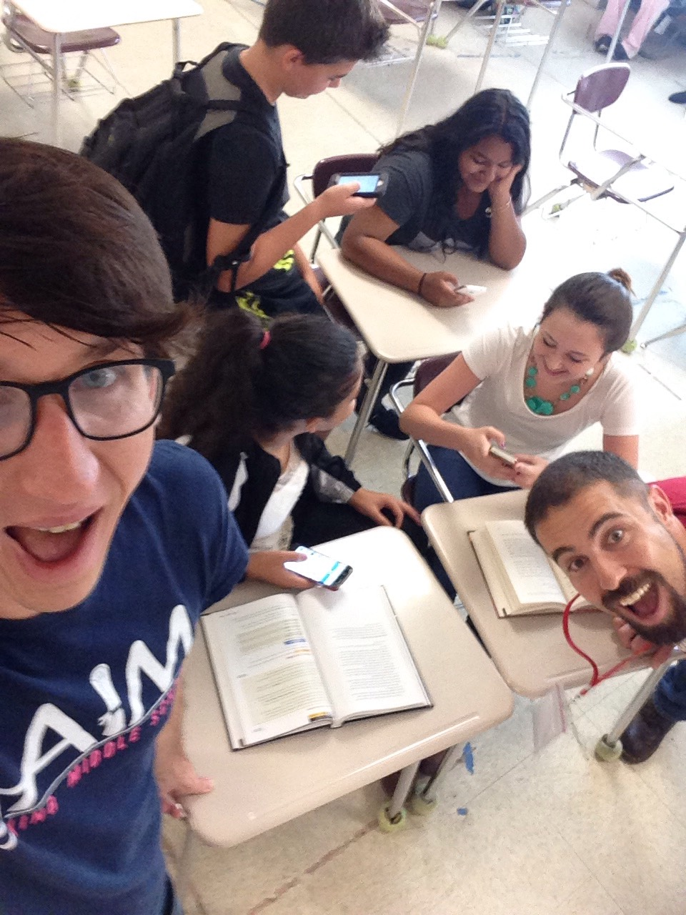
Final thoughts…
A phone is a tool, it’s up to us how we and our children use it.
If a phone can be used to spread negativity, it could instead be used to spread knowledge and great good.

